Slide 1
Java Database Connectivity

Slide 2
Version Control and Revision History
 | Name | Date
Prepared By | Paranthaman | 09-07-2019
Reviewed By | Team | 09-07-2019
Approved By | Team | 09-07-2019
Version No. | Date | Affected Sections | Highlights
2.0.0 |  | ALL | Updated Based on the course sheet coverage

Slide 3

Objective
To understand JDBC API
To know types of drivers
To implement database connectivity to different databases using JDBC
Notes:
It should be mentioned to the participant that current version of Java is 1.5, although not covered as part of this training.

Slide 4

Contents
What is JDBC
Architecture of JDBC
Types of Divers
Implementing JDBC
Fetching the MetaData
DataSource and Connection Pooling
Rowsets
Notes:
It should be mentioned to the participant that current version of Java is 1.5, although not covered as part of this training.

Slide 5
Java Database Connectivity
What is JDBC?
Defines how a java program can communicate with a database.
JavaSoft worked with D/B tool vendors to provide DBMS independent mechanism to write client side applications
The result is JDBC API
JDBC API is designed to allow developers to create database front ends without having to continually rewrite the code
An API that is D/B independent and uniform across databases
It has through a set of interface that are implemented by the driver.
Driver is responsible for converting a standard JDBC call to a native call.
JDBC API has two major packages
java.sql and
javax.sql.
This new JDBC API moves Java applications into the world of heavy-duty database computing.

Slide 6
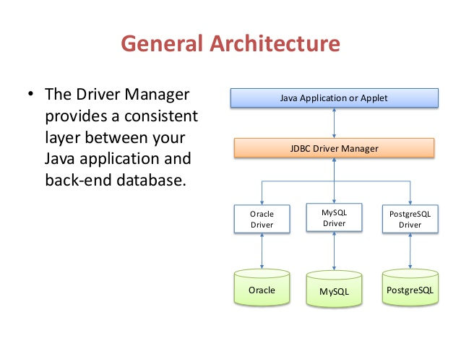
Java Database Connectivity
JDBC architecture consist of different layers and drivers which are capable of working with any database

Slide 7
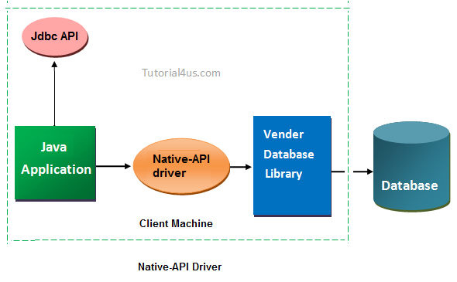

Driver and API

Slide 8
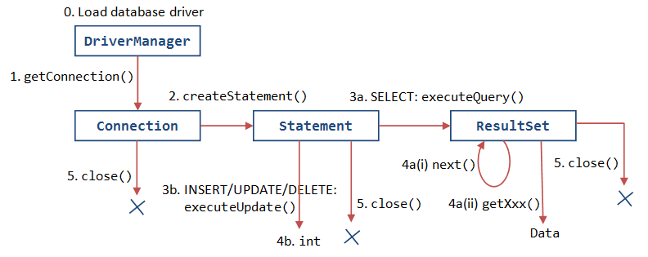
Java Database Connectivity Steps

Slide 9
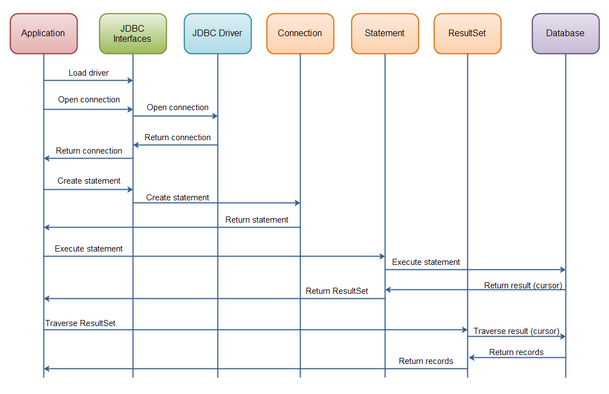
Java Database Connectivity Steps

Slide 10
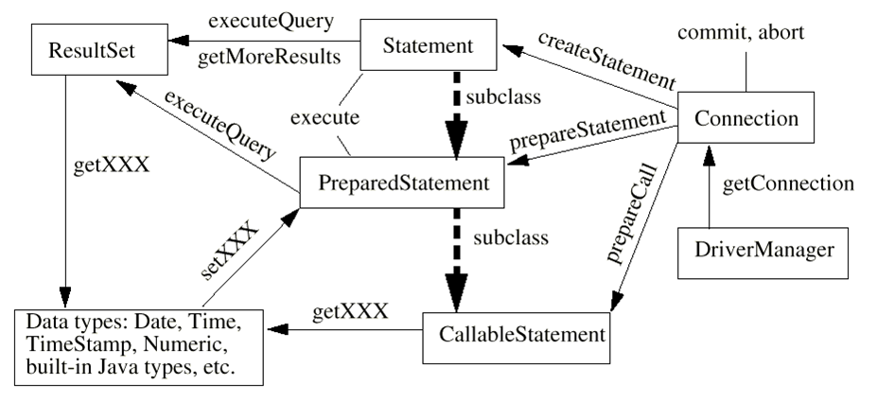
Java Database Connectivity

Slide 11
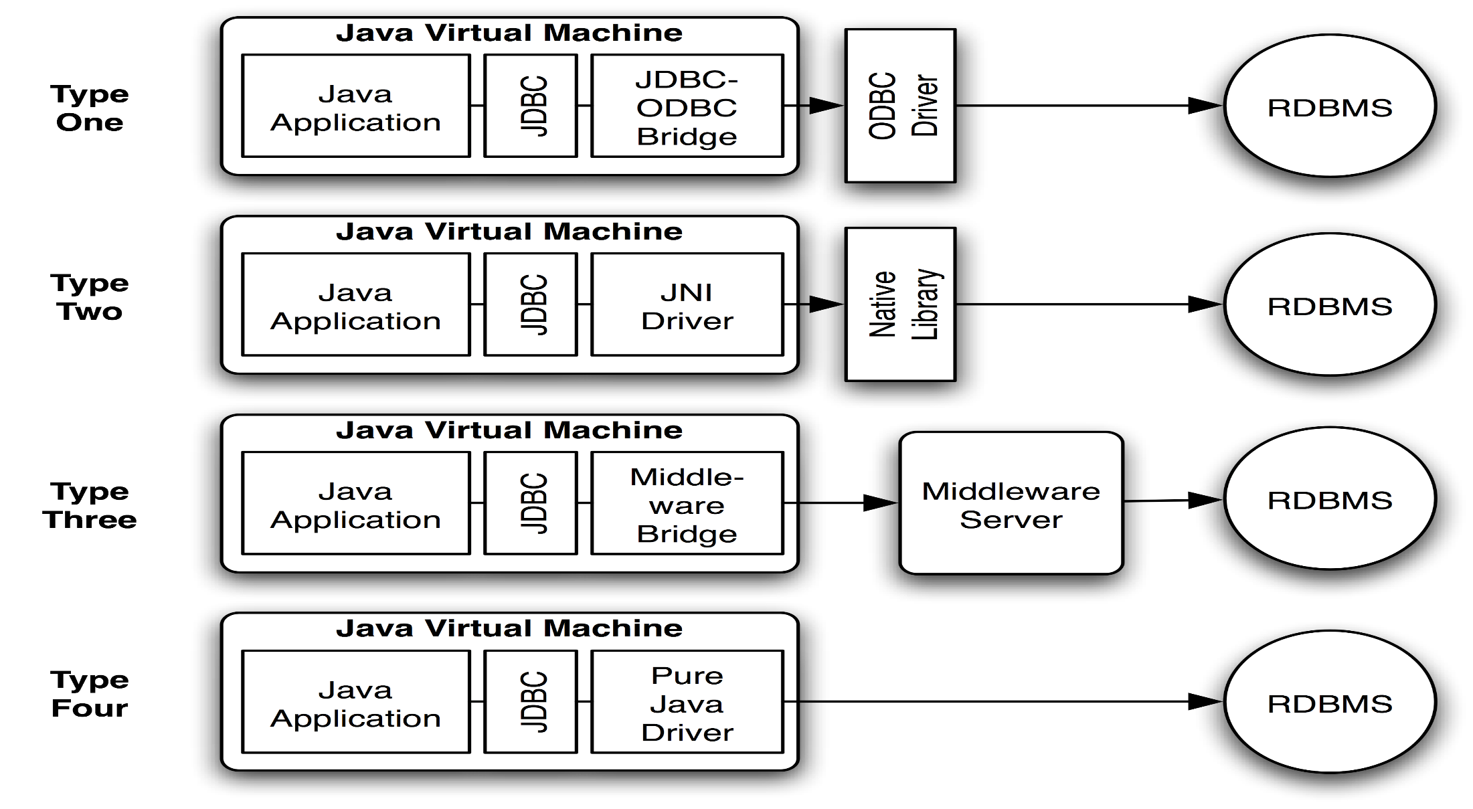
Type of JDBC Drivers

Slide 12
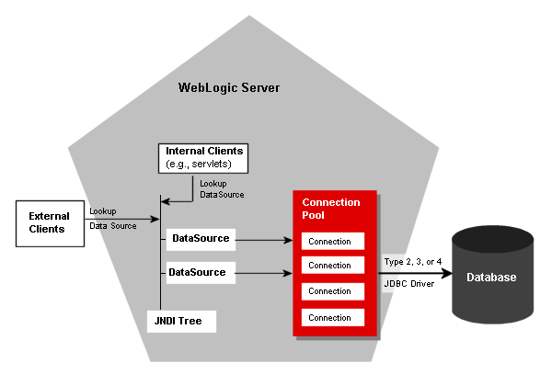
JDBC Connection Pooling

Slide 13
Java Database Connectivity
JDBC API supports both two-tier and three-tier models for database access
JAVA Application
Client GUI
Java Applet or HTML browser
JDBC
HTTP,RMI,CORBA
Application server (JAVA)
Propriety protocol
Business logic
Database server
JDBC
Propriety protocal
DBMS
DBMS
Two-tier JDBC
Three-tier JDBC

Slide 14
Java Database Connectivity
JDBC API
JDBC has four primary pieces, used for each database access phase:
DriverManager:
the DriverManager class loads and configures a database driver on the database
Connection:
The Connection class performs confectioning and authentication to a database
Statement / PreparedStatement:
The Statement and PreparedStatement classes send SQL statements to the database engine for preprocessing and eventually execution
ResultSet:
the ResultSet class allows for the inspection of results from executions

Slide 15
Java Database Connectivity
Dealing with Databases
Steps Involved
Load or register the driver with Class.forName().
Establish Connection with the database with Connection Interface.
Create Statement objects for Queries.
Execute the statements which may or may not return ResultSet.
Manipulate the ResultSet.
Close the Statements and Connection objects.

Slide 16
Type –I Driver
JDBC-ODBC Bridge driver
The Type 1 driver translates all JDBC calls into ODBC calls and sends them to the ODBC driver. ODBC is a generic API.
The JDBC-ODBC Bridge driver is recommended only for experimental use or when no other alternative is available.
Advantage
The JDBC-ODBC Bridge allows access to almost any database, since the database's ODBC drivers are already available.
Disadvantages
1. Since the Bridge driver is not written fully in Java, Type 1 drivers are not portable.
2. A performance issue is seen as a JDBC call goes through the bridge to the ODBC driver, then to the database, and this applies even in the reverse process. They are the slowest of all driver types.
3. The client system requires the ODBC Installation to use the driver.
4. Not good for the Web.

Slide 17
Type – 2 Driver
JDBC Driver :Native-API/partly Java driver
The distinctive characteristic of type 2 jdbc drivers are that Type 2 drivers convert JDBC calls into database-specific calls i.e. this driver is specific to a particular database.
Example: Oracle will have oracle native api.
Advantage
They offer better performance than the JDBC-ODBC Bridge as the layers of communication (tiers) are less and also it uses Native api which is Database specific.
Disadvantage
1. Native API must be installed in the Client System and hence cannot be used for the Internet.
2. It’s not written in Java Language which forms a portability issue.
3. If we change the Database we have to change the native api as it is specific to a database
4. 5. Usually not thread safe. And is mostly obsolete now.

Slide 18
Type – 3 Driver
Type3 : All Java/Net-protocol driver
Type 3 database requests are passed through the network to the middle-tier server which then translates the request to the database. If the middle-tier server can in turn use Type1, Type 2 or Type 4 drivers.
Advantage
1. This driver is server-based, so there is no need for any vendor database library to be present on client machines.
2. This driver is fully written in Java and hence Portable. It is suitable for the web.
4. The net protocol can be designed to make the client JDBC driver very small and fast to load.
5. The type 3 driver typically provides support for features such as caching (connections, query results, and so on), load balancing, and advanced system administration such as logging and auditing.
6. This driver is very flexible allows access to multiple databases using one driver.
7. They are the most efficient amongst all driver types.

Slide 19
Type – 4 Driver
Type4: Native-protocol/all-Java driver
The Type 4 uses java networking libraries to communicate directly with the database server.
Advantage
1. They are completely written in Java to achieve platform independence and eliminate deployment administration issues. It is most suitable for the web.
2. Number of translation layers is very less i.e. type 4 JDBC drivers don't have to translate database requests to ODBC or a native connectivity interface or to pass the request on to another server, performance is typically quite good.
3. You don’t need to install special software on the client or server. Further, these drivers can be downloaded dynamically.
Disadvantage
With type 4 drivers, the user needs a different driver for each database.

Slide 20
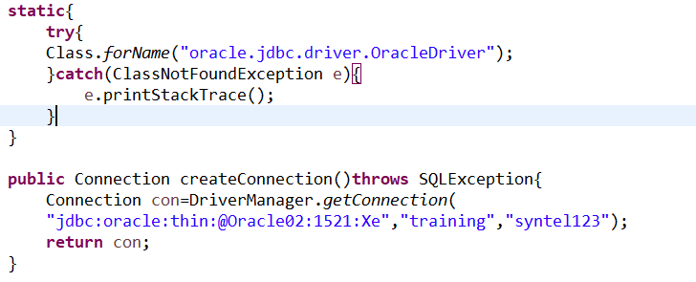
Java Database Connectivity
Step 2: Establish Connection with the database with Connection Interface.
DriverManager:
DriverManager is considered the backbone of JDBC architecture. It manages the JDBC drivers that are installed on the system.
Its getConnection() method is used to establish a connection to a database.
A jdbc Connection represents a session/connection with a specific database. Within the context of a Connection, SQL, PL/SQL statements are executed and results are returned.

Slide 21
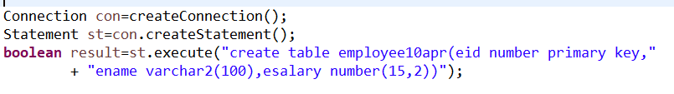
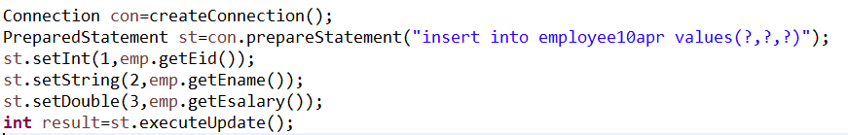
Java Database Connectivity
Step 3: Create Statement objects for Queries.
Once a connection is obtained we can interact with the database. Connection interface defines methods for interacting with the database via the established connection.
To execute SQL statements, you need to instantiate a Statement object from your connection object by using the createStatement() method.

Slide 22
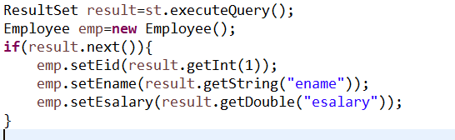
Java Database Connectivity
Step 4: Execute the statements which may or may not return ResultSet.
The Statement class has three methods for executing statements:
executeQuery(): For a SELECT statement, the method to use is executeQuery .
executeUpdate(): For statements that create or modify tables, the method to use is executeUpdate. Note: Statements that create a table, alter a table, or drop a table are all examples of DDL statements and are executed with the method executeUpdate.
execute() : executes an SQL statement that is written as String object.

Slide 23
Java Database Connectivity
Step 5: Manipulate the ResultSet:
ResultSet provides access to a table of data generated by executing a Statement.
The table rows are retrieved in sequence. A ResultSet maintains a cursor pointing to its current row of data.

Slide 24
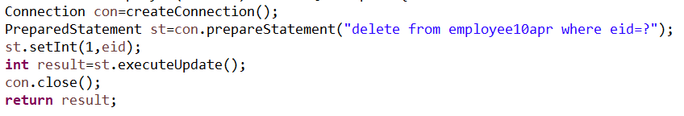
Java Database Connectivity
Step 6: Closing the Connections
close() is used with different interfaces

Slide 25
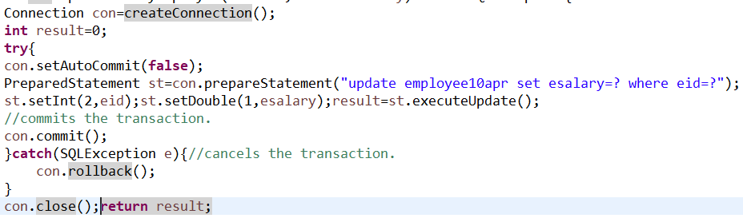
Transaction Management
Transaction Management:
Transactions are not explicitly opened and closed, Instead, the connection has a state called AutoCommit mode
if AutoCommit is true, then every statement is automatically committed.
Connection.setAutoCommit(boolean)
You must explicitly commit or rollback the transaction

Slide 26
Java Database Connectivity
There are two metadata available in the JDBC API –
ResultSetMetaData and DatabaseMetaData.
ResultSetMetaData:
It is used to make descriptive information about object, like; number of columns, name of columns and datatype of columns.
It does not provide any information regarding database and how many rows are available in the ResultSet object. Whether ResultSet is read only, updatable or scrollable.
To create object of ResultSetMetadata by calling getMetaData() method from ResultSet object.
DatabaseMetaData:
This interface provide comprehensive information about the database. It contains the information about Database Management System (DBMS) and all the objects in the database, like; all the tables, cataloge name, view, stored procedure etc.
To create DatabaseMetaData object by calling getMetaData() from Connection interface.

Slide 27
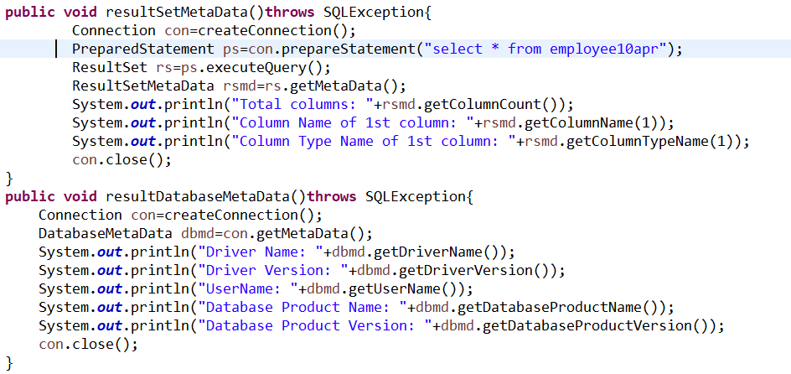
JDBC META DATA

Slide 28
Java Database Connectivity
DataSource and Connection Pooling
In a native SQL environment the most of the response time is used in creating and managing the connections in the database.
DataSource:
Introduced by JDBC 2.0 extension API
They are standard, general-use objects for specifying databases or other resources to use
It can reside on a remote server, or it can be on a local desktop machine
It can be thought of as a factory for connections to the particular data source that the DataSource instance represents
The DataSource interface is implemented by a driver vendor.

Slide 29
Java Database Connectivity
DataSource and Connection Pooling
DataSource(Contd..):
There are three types of implementations:
Basic implementation -- produces a standard Connection object
Connection pooling implementation -- produces a Connection object that will automatically participate in connection pooling. This implementation works with a middle-tier connection pooling manager.
Distributed transaction implementation -- produces a Connection object that may be used for distributed transactions and almost always participates in connection pooling. This implementation works with a middle-tier transaction manager and almost always with a connection pooling manager.
A driver that is accessed via a DataSource object does not register itself with the DriverManager. Rather an object that implements the DataSource interface will typically be registered with a naming service based on the Java Naming and Directory (JNDI) API.

Slide 30
Java Database Connectivity
DataSource and Connection Pooling
Connection Pooling:
There are many scenarios in software architecture where some type of object pooling is employed as a technique to improve application performance.
Object pooling is effective for two simple reasons.
First, the run time creation of new software objects is often more expensive in terms of performance and memory than the reuse of previously created objects.
Second, garbage collection is an expensive process so when we reduce the number of objects to clean up we generally reduce the garbage collection load.

Slide 31
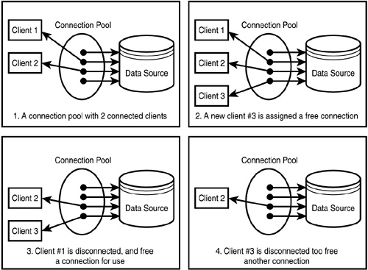
Java Database Connectivity
DataSource and Connection Pooling

Slide 32
Java Database Connectivity
DataSource and Connection Pooling
Connection Pooling(Contd..):
JDBC connection pooling is conceptually similar to any other form of object pooling.
Database connections are often expensive to create because of the overhead of
establishing a network
connection and initializing a database connection session in the back end database.
connection session initialization often requires
time consuming processing to perform user authentication, establish transactional contexts and establish other aspects of the session that are required for subsequent database usage.
Managing all of its connection sessions can impose a major limiting factor on the scalability of the application.
Valuable database resources such as locks, memory, cursors, transaction logs, statement handles and temporary tables all tend to increase based on the number of concurrent connection sessions.

Slide 33
Java Database Connectivity
DriverManager Vs DataSource
Connection is Retained in the pool in DataSource
While directly creating a connection by calling DriverManager.getConnection(..) , you are creating a connection by yourself and when closing close() on it, the link to database is lost.
On the other hand we get a connection from a datasource, when you call the close() on it, it will not close the link to database, but will return to a connection pool where it can be reused by some other classes
It is always better to use a connection pool because creating connections are expensive. DataSource has its usability in the distributed computing environment, as it can be used with JNDI lookups
allows developers to implement a DataSource class to take advantage of features like connection pooling and distributed transactions

Slide 34
Java Database Connectivity
Rowsets
RowSets are a JDBC 2.0 extension to the java.sql.ResultSet interface.
Included within the package javax.sql.*
A RowSet object contains a set of rows from a result set or some other source of tabular data, like a file or spreadsheet.
Rowsets may have many different implementations to fill different needs. These implementations fall into two broad categories:
Connected RowSets
Disconnected. RowSets
Rowsets make it easy to send tabular data over a network.
They can also be used to provide scrollable result sets or updatable result sets when the underlying JDBC driver does not support them.

Slide 35
Java Database Connectivity
Rowsets
Disconnected RowSets:
It gets a connection to a data source in order to fill itself with data or to propagate changes in data back to the data source, but most of the time it does not have a connection open.
Does not need a JDBC driver or the full JDBC API, so its footprint is very small.
Is an ideal format for sending data over a network to a thin client.
It stores its data in memory. It needs to maintain metadata about the columns it contains and information about its internal state.
It also needs a facility for making connections, for executing commands, and for reading and writing data to and from the data source
Example: CachedRowSet:
a disconnected rowset that caches its data in memory;
not suitable for very large data sets, but an ideal way to provide thin Java clients, such as a Personal Digital Assistant (PDA) or Network Computer (NC), with tabular data

Slide 36
Java Database Connectivity
Rowsets
Connected RowSets:
A connected rowset, by contrast, opens a connection and keeps it open for as long as the rowset is in use.
Example:
A JDBCRowSet class—a connected rowset that serves mainly as a thin wrapper around a ResultSet object to make a JDBC driver look like a JavaBeans component
A WebRowSet class—a connected rowset that uses the HTTP protocol internally to talk to a Java servlet that provides data access; used to make it possible for thin web clients to retrieve and possibly update a set of rows

Slide 37
Java Database Connectivity
ResultSet Vs Rowset
ResultSet | RowSet
A ResultSet maintains a connection to a database and because of that it can’t be serialized and also we cant pass the Resultset object from one class to other class across the network | RowSet is a disconnected, serializable version of a JDBC ResultSet and also it can be sent from one class to another across the network
Since the data is fetched directly from the database Connection there is problem even if the query returns a huge set of rows | Rowset keeps all the data from the query result in-memory. This is very in-efficient with queries that return huge data.
When using a ResultSet, we can requery the same column using getXX (...) method to retrieve the result as a different datum. | As the data from the resultset is preloaded into the Rowset, you cannot requery a particular column as a different datum.

Slide 38
Java Database Connectivity
Rowsets
Limitations
As all the table rows are taken into memory, care should be taken with the query which retrieves the number of rows, as it will be very resourceful if huge set of rows is taken and the application will get very slow.
As rowsets will keep a connection to itself , hence the connection object will be kept at the client which make the client heavy. As it can modify data at the client side inconsistency may arise with the server containing actual data.

